Slide 1
Summary
Streamline can be drawn with forward tracing, backward tracing, and both.
Backward pathline tracing is not supported from the library. But it is possible by inversing time frame order and vector direction.
Pathlines are successfully divided by a plane (or valve).

Slide 2
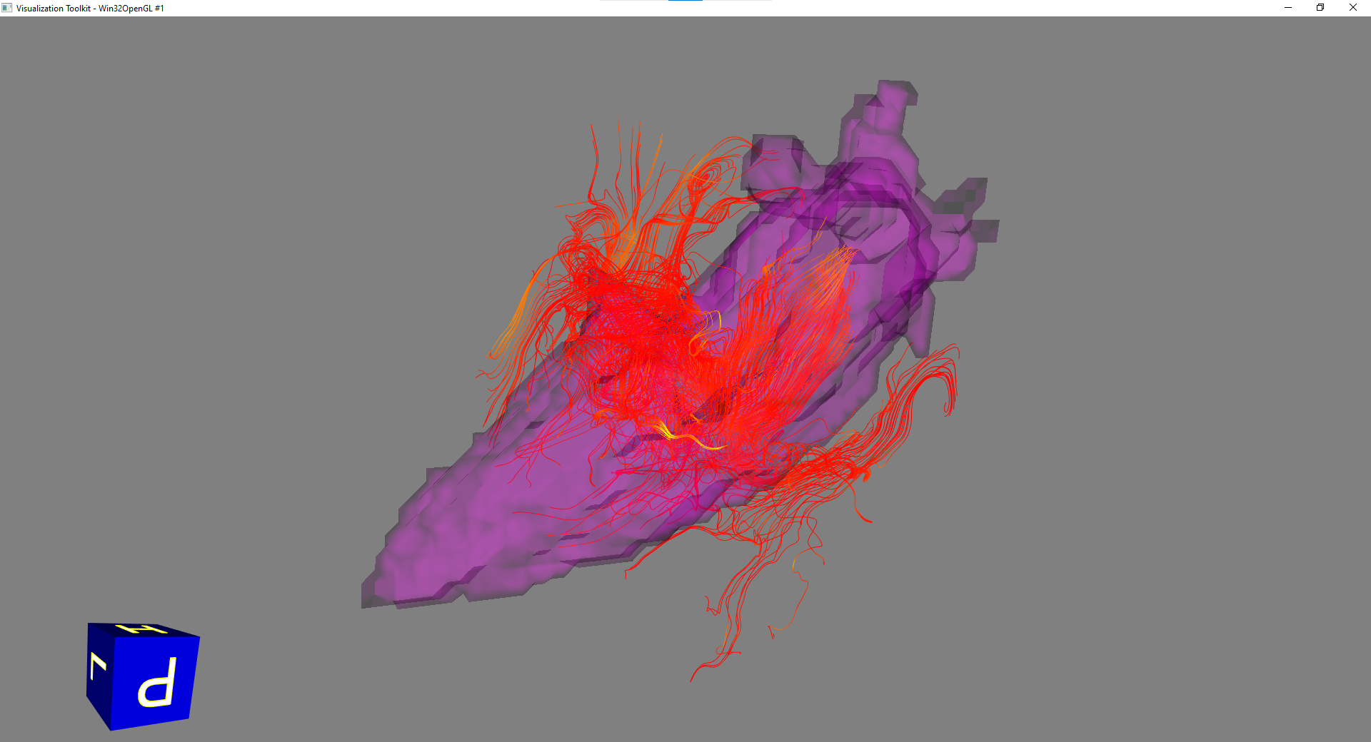
Streamline (Forward and Backward tracing, time phase = 9)
For a given timing, streamline can be drawn with forward tracing, backward tracing, and both of them.

Slide 3
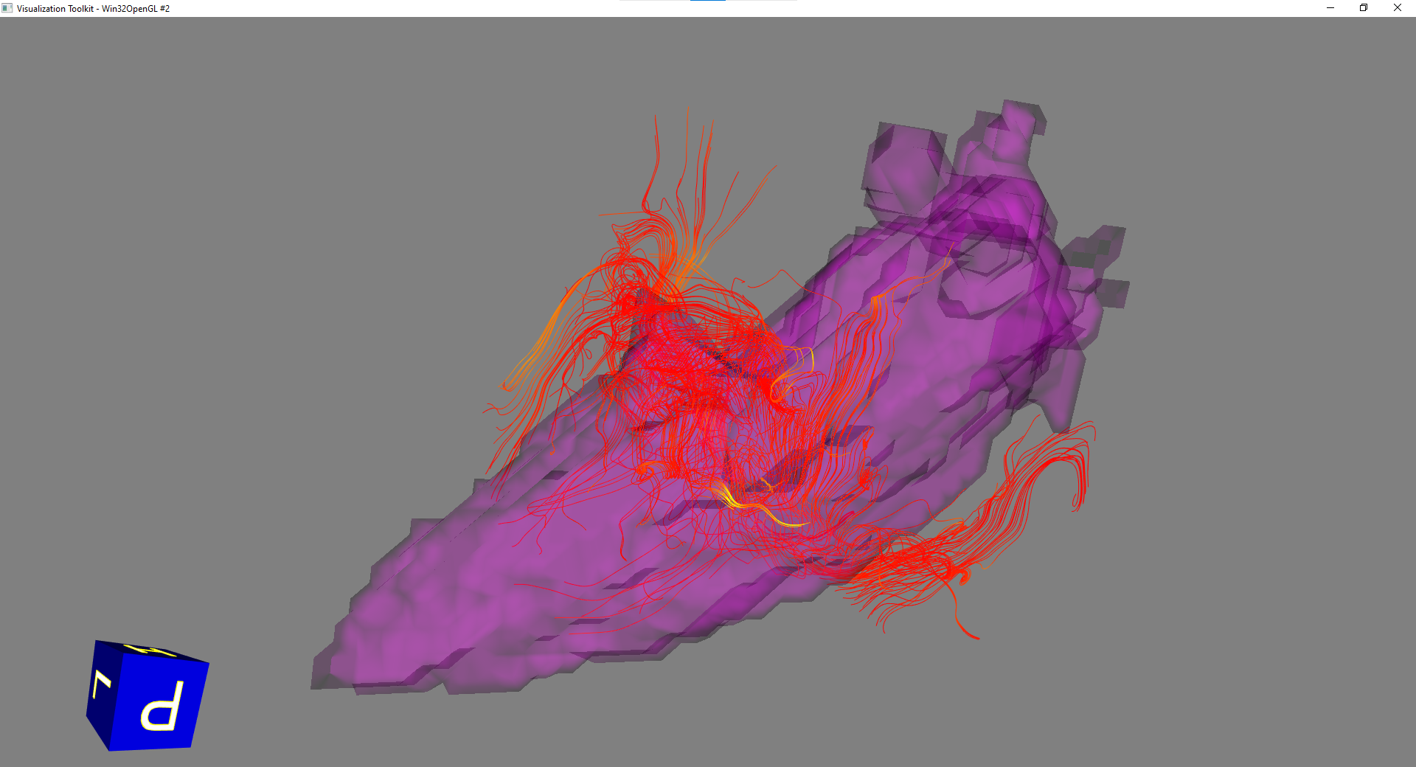
Streamline (Forward tracing, time phase = 9)

Slide 4
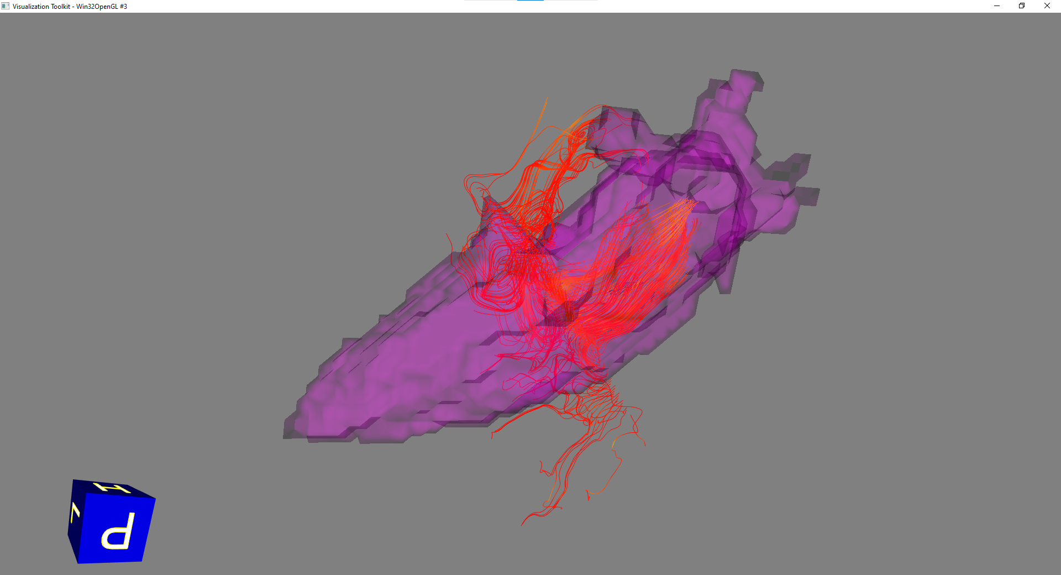
Streamline (Backward tracing, time phase = 9)

Slide 5
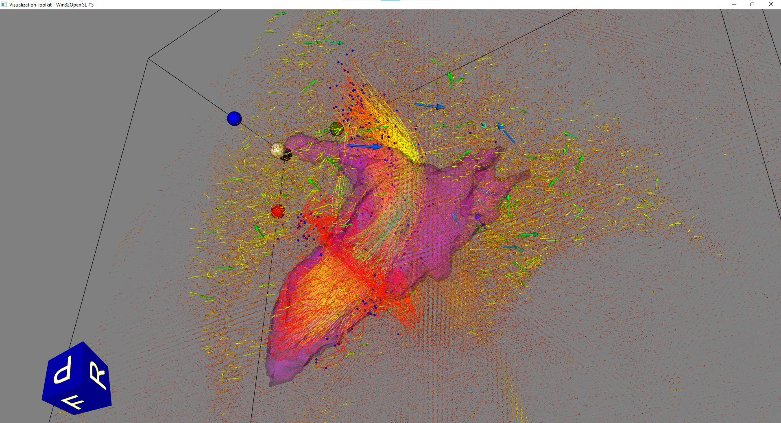
Pathline (forward tracing from MV)
0 | 1 | 2 | 3 | 4 | 5 | 6 | 7 | 8 | 9 | 10 | 11 | 12 | 13 | 14 | 15

Slide 6
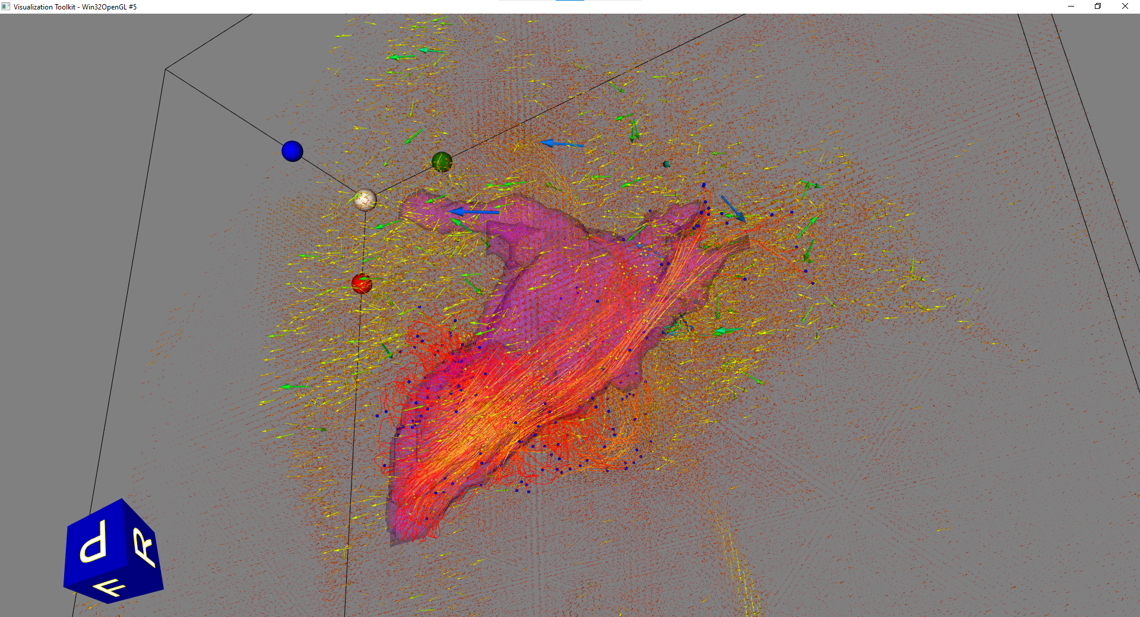
Pathline (backward tracing from AV)
Vector direction also inversed.
newVx = -Vx
newVy = -Vy
newVz = -Vz
0 | 1 | 2 | 3 | 4 | 5 | 6 | 7 | 8 | 9 | 10 | 11 | 12 | 13 | 14 | 15

Slide 7
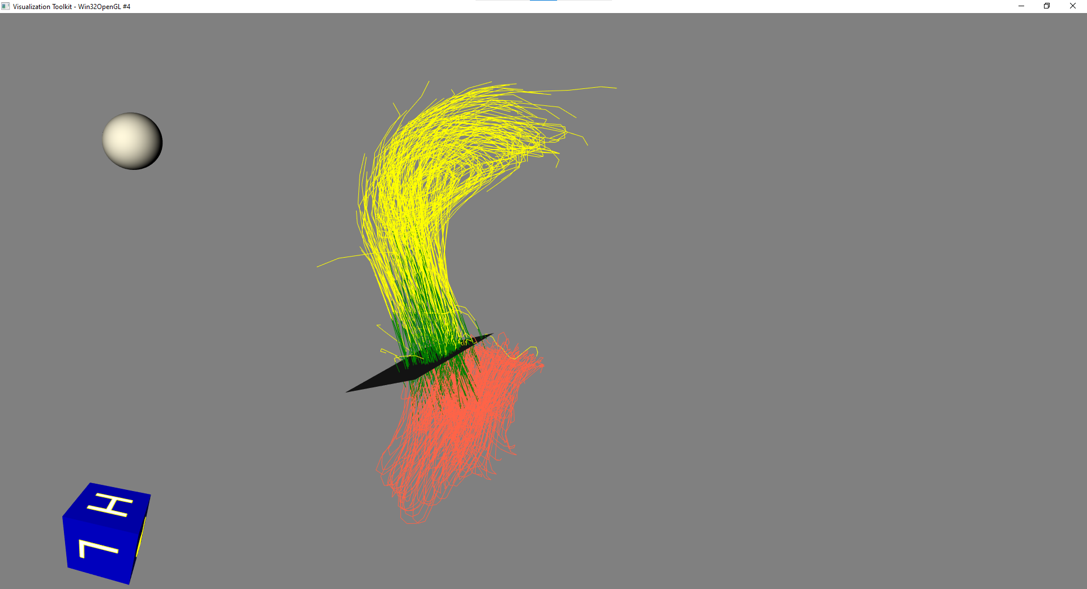
Pathlines and plane crossing test
Particle Injection
(Mitral valve)
Particles are injected at time index 9.
Particles are traced for a full heart cycle.
(time index 9..15, 0..9)
Each line segment was tested whether it has intersection with the plane.
Here, they are represented as
Red: inside the chamber
Green: crosses the plane
Yellow: outside the chamber
Pathlines that does not cross the testing plane were ignored.
Testing Plane
(Aortic valve)
0 | 1 | 2 | 3 | 4 | 5 | 6 | 7 | 8 | 9 | 10 | 11 | 12 | 13 | 14 | 15

Slide 8
Pathlines and plane crossing test
### Number of Cells 441
Intersection line 52 segment 5 at [178.06978529205443, 147.2661804195047, 69.15543244671052], inward
Intersection line 52 segment 11 at [174.280473105403, 137.9335587579072, 68.74617593159834], outward
Intersection line 53 segment 5 at [180.47455637560236, 148.81439907702475, 66.58760271434889], inward
Intersection line 53 segment 11 at [174.8265169017738, 142.2231412977263, 70.70857168717289], outward
Intersection line 73 segment 4 at [177.78310690034806, 146.35950533114223, 68.99479330006822], inward
Intersection line 73 segment 10 at [170.0644349534382, 132.59439298604588, 71.55144934593429], outward
Intersection line 74 segment 4 at [177.95852424394172, 145.4627309036188, 68.15482547385561], inward
Intersection line 74 segment 9 at [171.87946934051467, 133.12678408924927, 69.20215075447284], outward
Intersection line 75 segment 3 at [180.22527228820925, 146.5476543726828, 65.49235082377739], inward
Intersection line 75 segment 11 at [173.7669659559862, 138.7085606321124, 70.00914177182516], outward
Intersection line 76 segment 2 at [182.38672910009552, 149.6245337439017, 64.2736832093339], inward
Intersection line 76 segment 10 at [173.5681961790092, 140.18719017350244, 71.25986282855862], outward
Intersection line 77 segment 2 at [184.22953741796636, 151.56241286475435, 62.791648307961744], inward
Intersection line 77 segment 8 at [177.34734277587563, 145.26136848257207, 68.93163335472553], outward
Intersection line 78 segment 3 at [184.47402585600202, 150.68092294508932, 61.859061832238105], inward
Intersection line 78 segment 9 at [175.33690557556218, 141.84991798136446, 69.70993501260952], outward

Slide 9
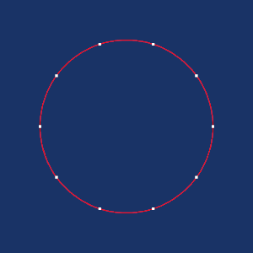
Further work
Contour drawing for valve definition.
Currently, the particle injection plane and the testing plane are rectangle.
Contour drawing widget can be used to define valves in circular or arbitrary shape.
Temporal interpolation
The library provides temporal interpolator.
Time steps can be divided into 2-folds or 3-folds, and it may make pathlines softer.
How to calculate the residual volume?

